Slide 1

-XXdB
XXdB
XXdB
XX dBi
z⁻¹
ENV
XX dB
XX MHz
Fc XX MHz
X-bit
8:1
ADC
XX MHz
Fs=XX Msps
X-bit
DAC
Fs=XX Msps

Slide 2
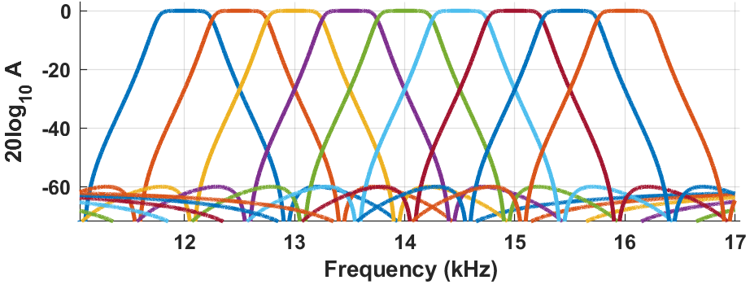
Fc 10 MHz
ENV
ADC
500Hz
Fs=10sps
1
Fc 10 MHz
Fc 10 MHz
Fc 10 MHz
10 MHz
ENV
ADC
XX MHz
0 dBi
0dB
2 MHz
100 KHz
500Hz
Fs=10sps
Fc 10 MHz
ENV
ADC
YY MHz
Range Gate
500Hz
Fs=10sps

Slide 3
Filters
IIR Filter Bi-Quad Section
(Direct Form I)
FIR Filter Section
(3 Taps)
u[k]
z⁻¹
z⁻¹
u[k]
z⁻¹
z⁻¹
b₀
b₁
b₂
b₀
b₁
b₂
y[k]
y[k]
-a₁
-a₂
-a₁
-a₂
z⁻¹
z⁻¹
z⁻¹
z⁻¹

